Slide 1
Evolving Role of University* Archivists
Kari R. Smith
Institute Archivist, Massachusetts Institute of Technology

Slide 2
Survey for University Archivists
Marketed the survey at SAA C&U Archives Section and the ICA-SUV
Survey open for 30 days
72 responses
Positioning (physical, administrative, conceptual, as per Todd-Diaz)
Roles
Current or Desired collaboration on campus and externally

Slide 3
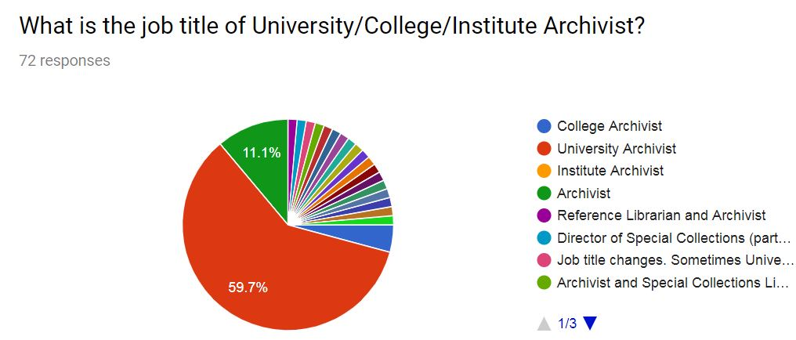
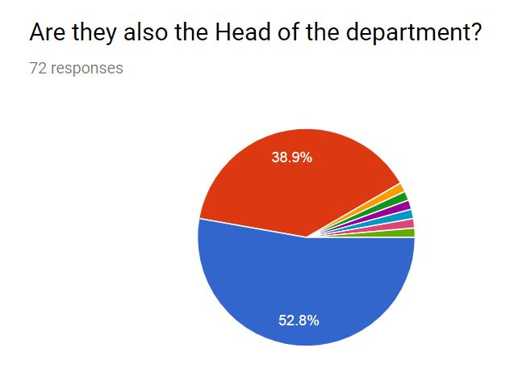

Slide 4
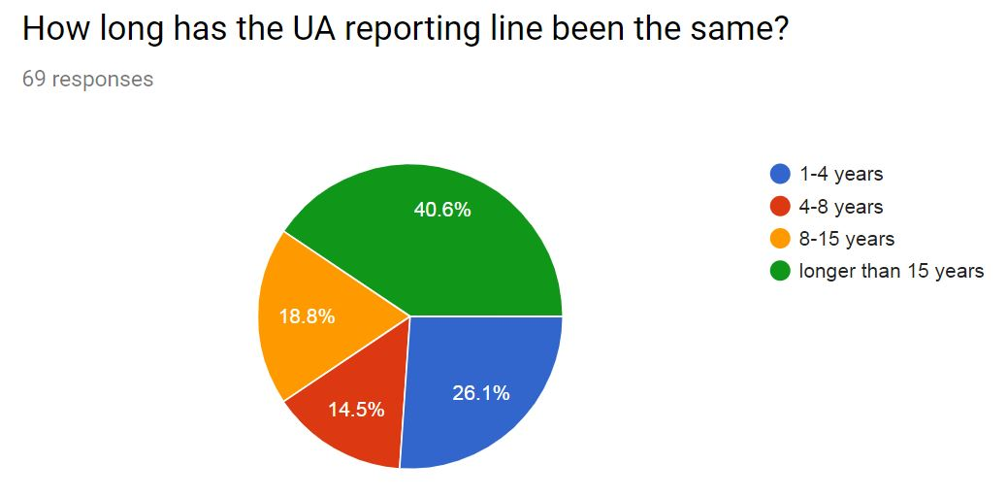

Slide 6
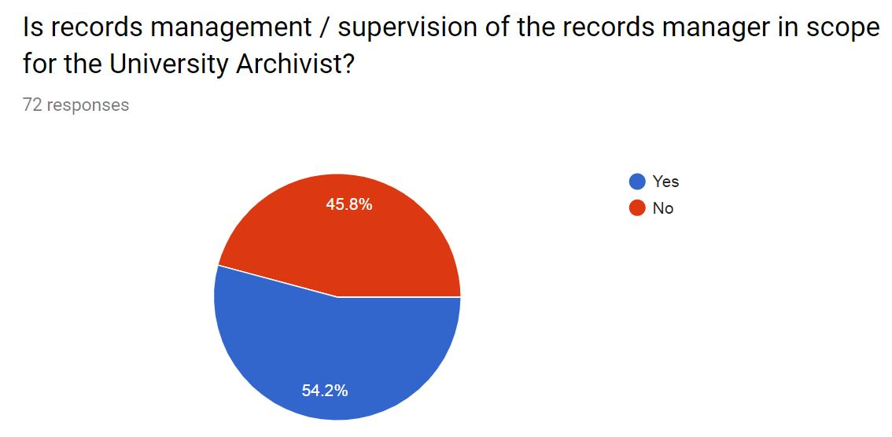
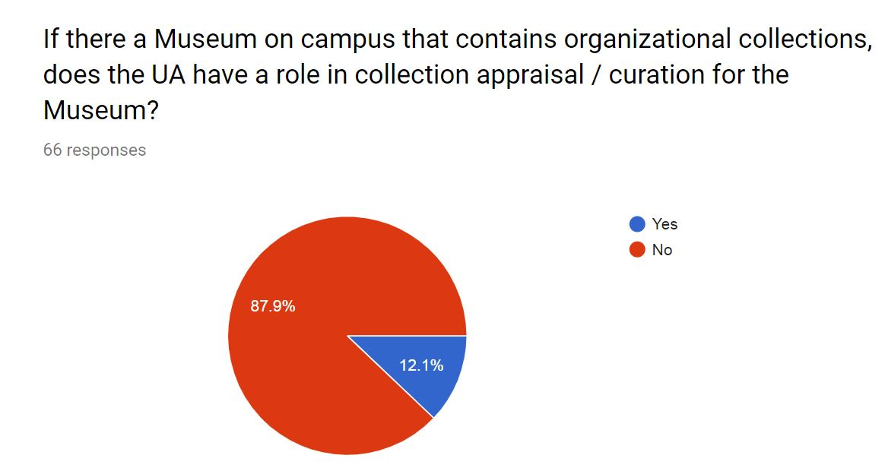

Slide 7
Opportunities for Radical Collaboration
Are there Organizational or Libraries-wide committees that the UA is a standing member of? If so, what are they. If not, on which would you like to be a standing member?
What is the correlation between UA’s who are not Head of Department and their opportunities for collaboration?
What collaboration opportunities for University Archivists can be identified to develop the activities and roles of UAs?

